Slide 1
Capstone Project Advises for Dinner Takeout and Grocery Shopping During the Pandemic Period Mei Ding May 2020

Slide 2
Introduction
During Covid 19, many restaurants and markets are closed.
Where to order dinner while maintaining low risk of exposure to coronavirus?
Where to shop for grocery safely?
We will build a data clustering model to provide advises and guidance.

Slide 3
Data
1. Coronavirus cases csv file, uploaded to the data asset on IBM Watson
2. Geospatial data for 70 boroughs in Bergen County, NJ This data is retrieved using the geocode library.
3. Venue information FourSquare API https://foursquare.com/developers/api
4. Distance between venue and my home Calculated using pyproj geod library.

Slide 4
Methodology
K-Means clustering Used to cluster restaurants and supermarkets based on # of coronavirus cases, venue rating, and distance to my home
Z-score normalization Normalize data before applying K-Means clustering
Folium map Visually present the clustering and segmentation. The plot empowers a user to quickly choose a venue.

Slide 5
Data Analysis and Data Modeling Process
Step 1. Data collection and wrangling
Data includes coronavirus cases, geospatial data for 70 boroughs, restaurant and supermarket rating and open status.
Step 2. Build data clustering model for supermarkets
Model is built based on # of coronavirus cases, venue rating, and distance to my home.
Step 3. Build data clustering model for restaurants
Model is built based on # of coronavirus cases, venue rating, and distance to my home.

Slide 6
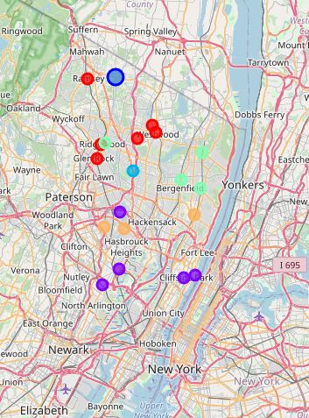
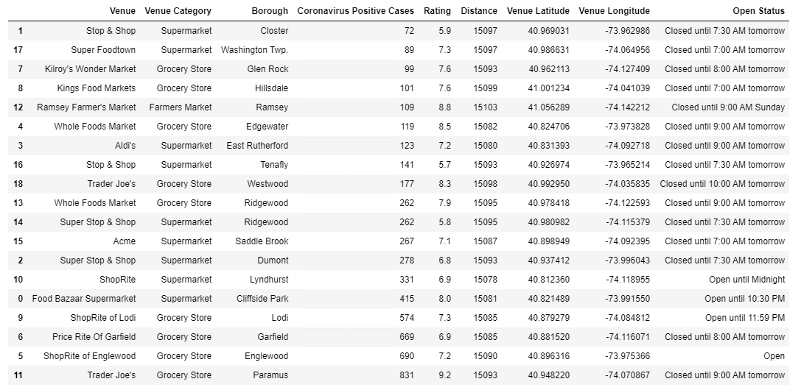
Supermarket Clustering

Slide 7
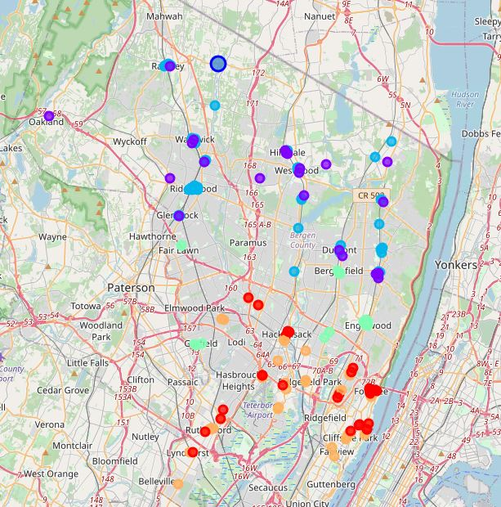
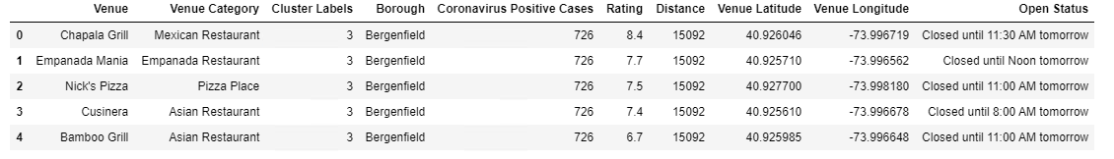
Restaurant Clustering

Slide 8
Conclusion
1. Built data clustering and segmentation model to find the venues with good ratings, low coronavirus cases, and short driving distance.
2. Models can be very useful in advising people as to where to go for dinner takeout and grocery shopping while keeping less exposure to coronavirus.
3. Models could be easily adapted to any location/district in the US.

